Slide 1

Improving the identifiability of hydrological model parameters through remotely sensed data and sequential calibration
Jesús Casado-Rodríguez, Manuel del Jesus, Salvador Navas

Slide 2
1. Introduction
Hydrological models have nowadays a vast number of parameters.
The problem of parameter identifiability and computational effort.
Calibrating several target variables (Beven, 1992), instead of simply discharge.
Remote sensing becomes an invaluable source of information.
P T
β FC₀
ET_{p} λ_{v} FC₂
I_{max}
DDF₁ DDF₂ T_{b}
ET_{p} θ* λ_{v} FC₂
p₁
κ φ c₁ ε₁ c_{d} θ c_{n} ξ
FC₉
H_{u} ∙ FC₁
k_{s} FC₃
v_{t} FC₄
Objectives
Use satellite products to calibrate spatial processes in the water cycle.
Snow.
Evapotranspiration.
k_{p} FC₅
H_{3max}
.
k_{ss} FC₆
k_{ps} FC₇
k_{sa} FC₈

Slide 3
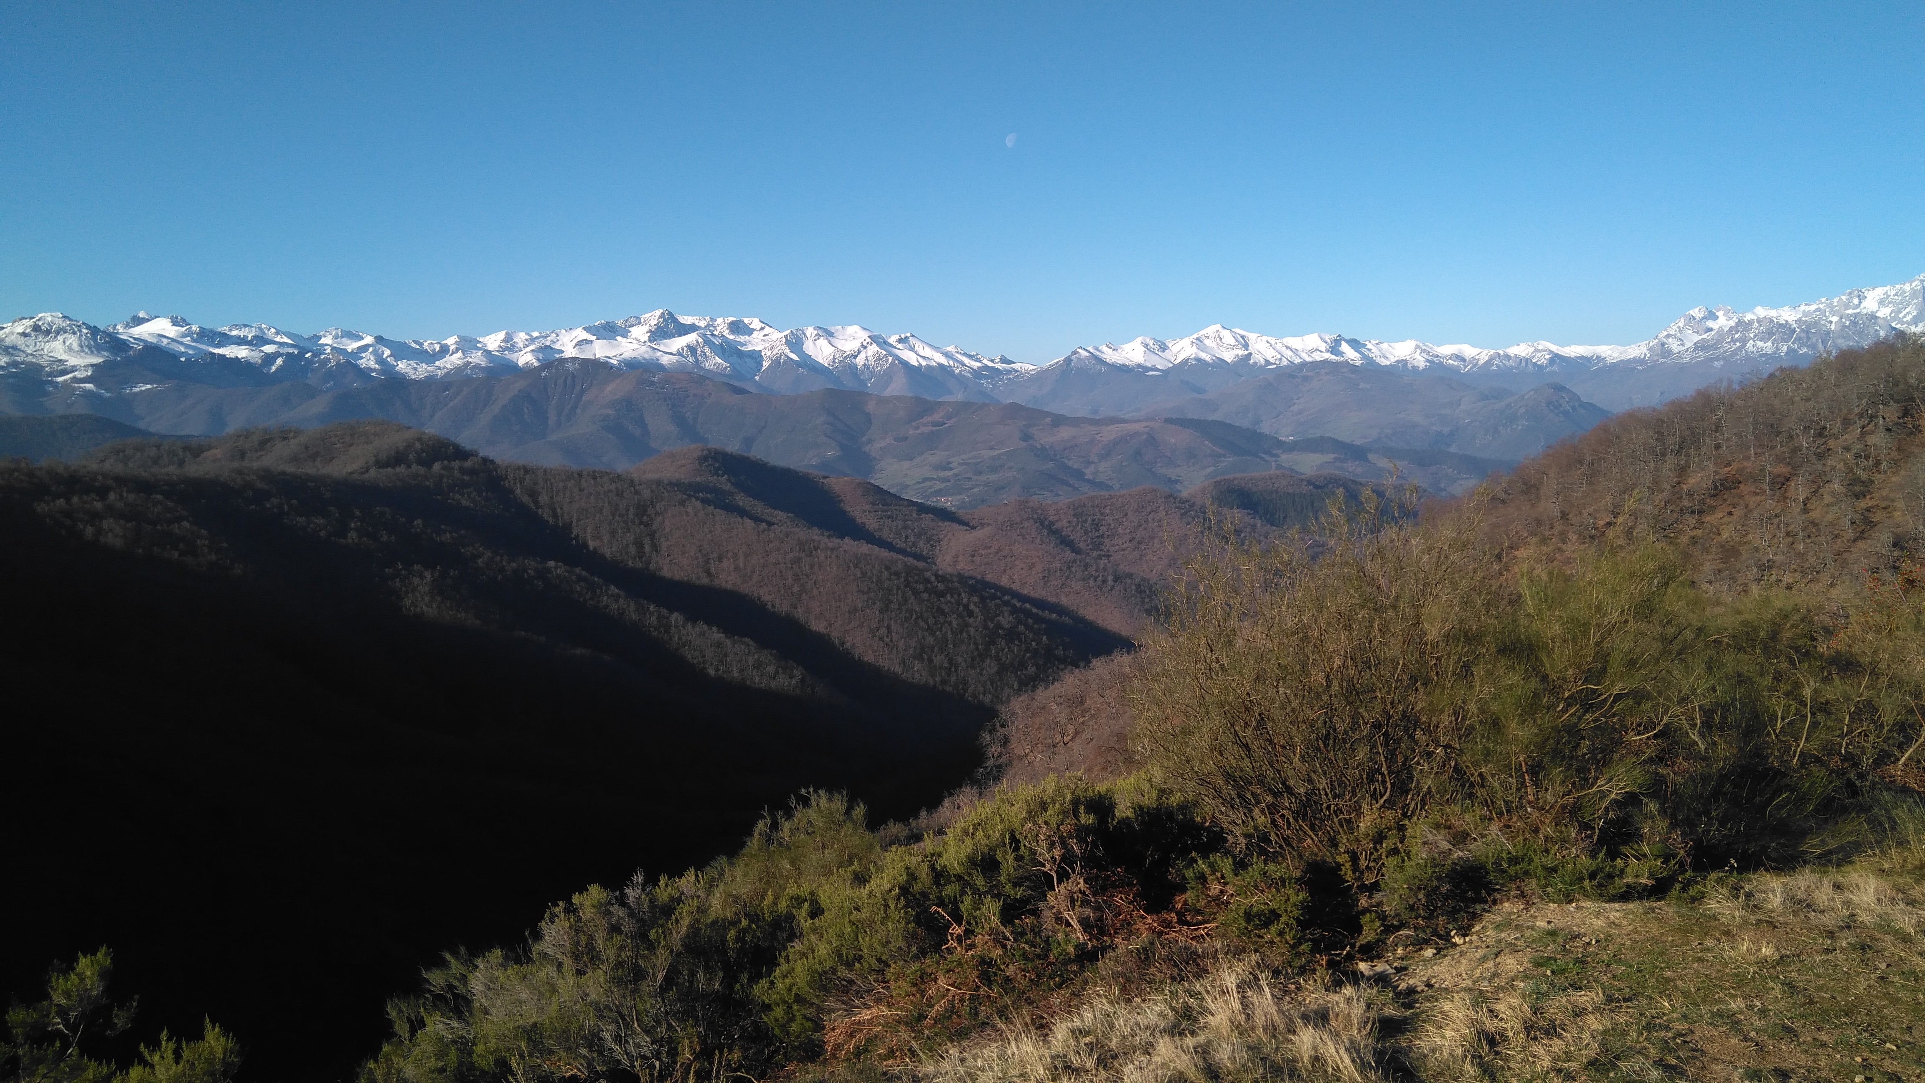
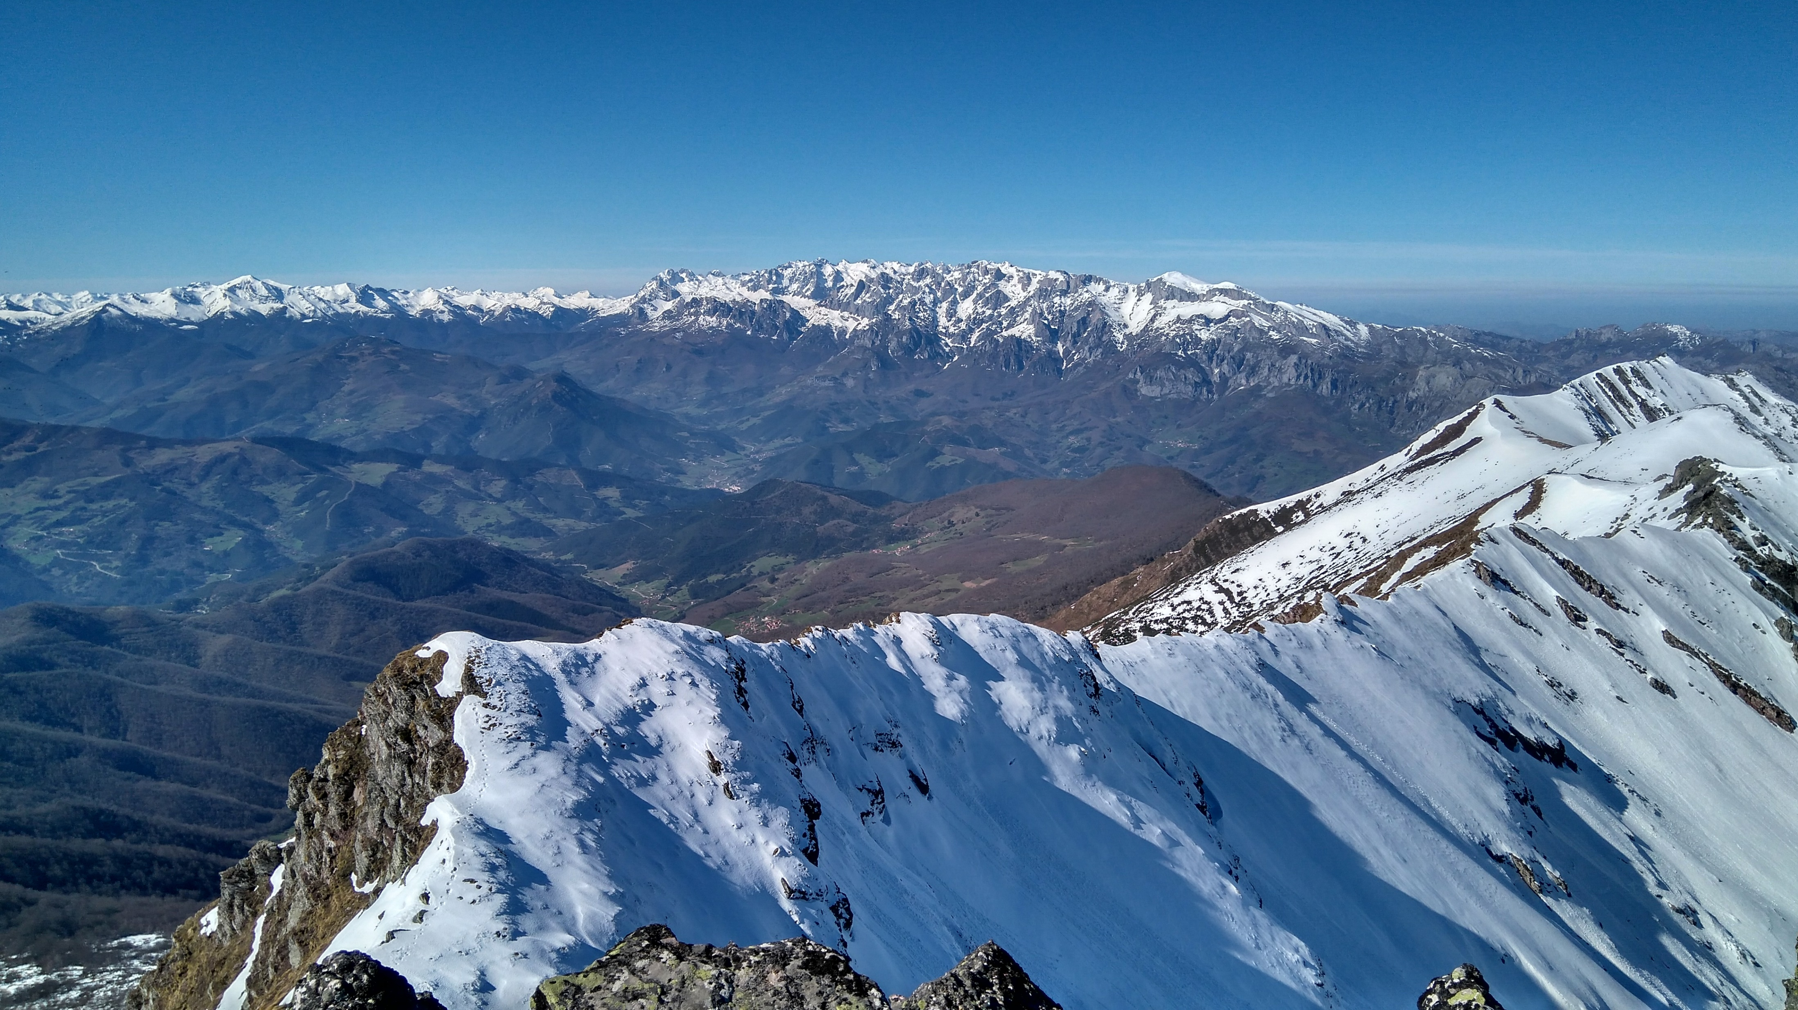
2. Study area and data
Upper Deva basin (Northern Spain)
Area: 291 km²
Elevation: mean 1167 msnm
max 2614 msnm
Land cover: forest 44 %
shrubland 35 %
Climate: precipitation 1650 mm
temperature 11 °C
Climate data
Daily maps of precipitation and temperature.
Daily maps of potential evapotranspiration: Hargreaves method (Hargreaves, 1985).
Monthly incoming radiation maps.

Slide 4
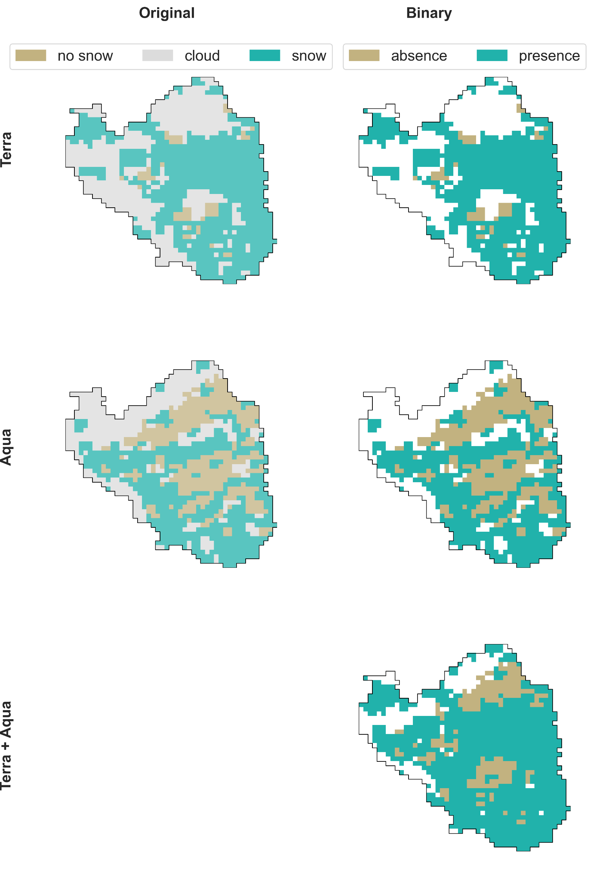
27-12-2005
Original
Binary
2. Study area and data
Snow cover
Terra
MODIS products for maximum snow cover: MOD10A2 (Terra), MYD10A2 (Aqua)
Temporal coverage: since 2001
Temporal resolution: 8 days
Spatial resolution: 465 m
Convert original products to binary maps (presence vs absence of snow).
Combine the data from both satellites.
Aqua
Terra + Aqua

Slide 5
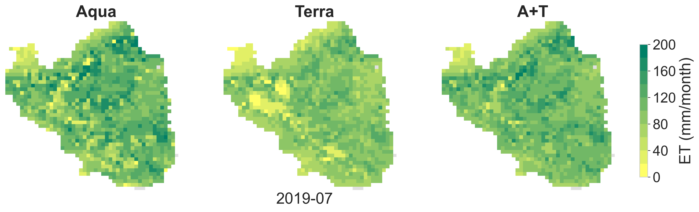
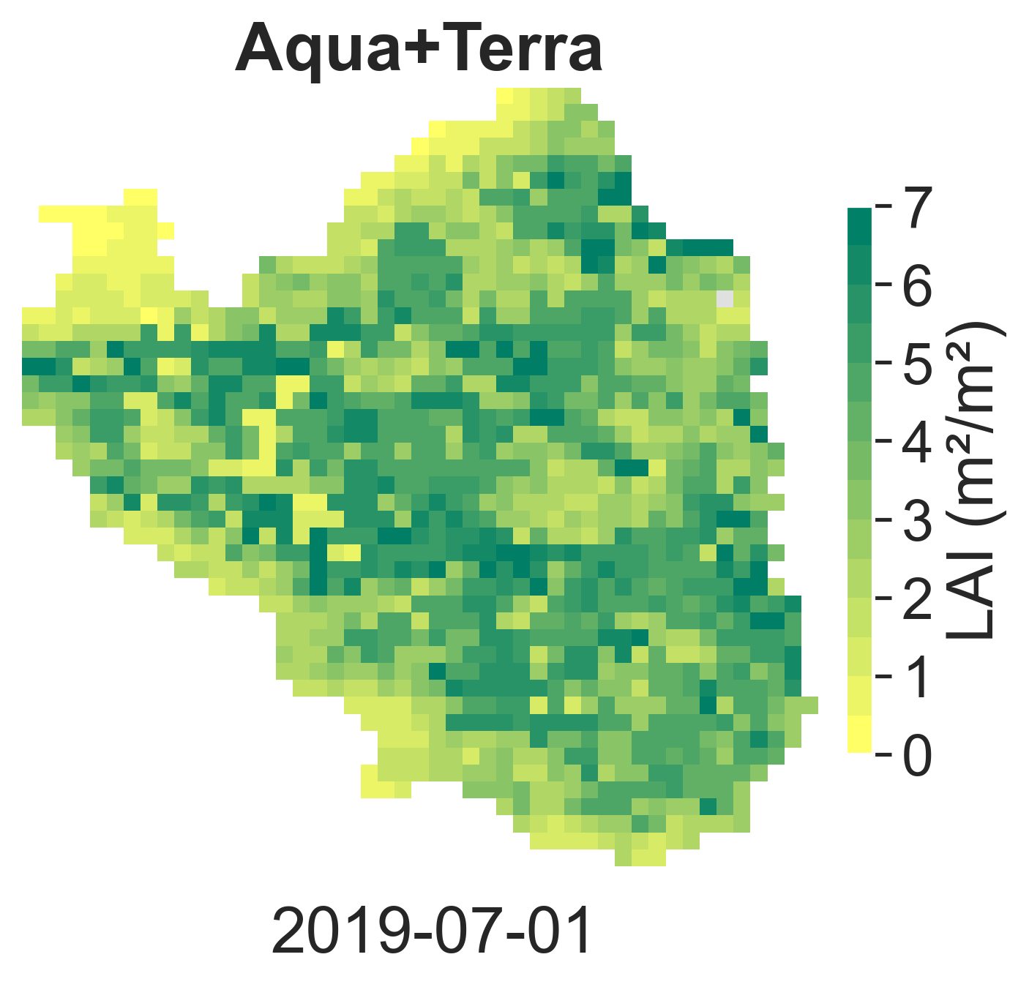
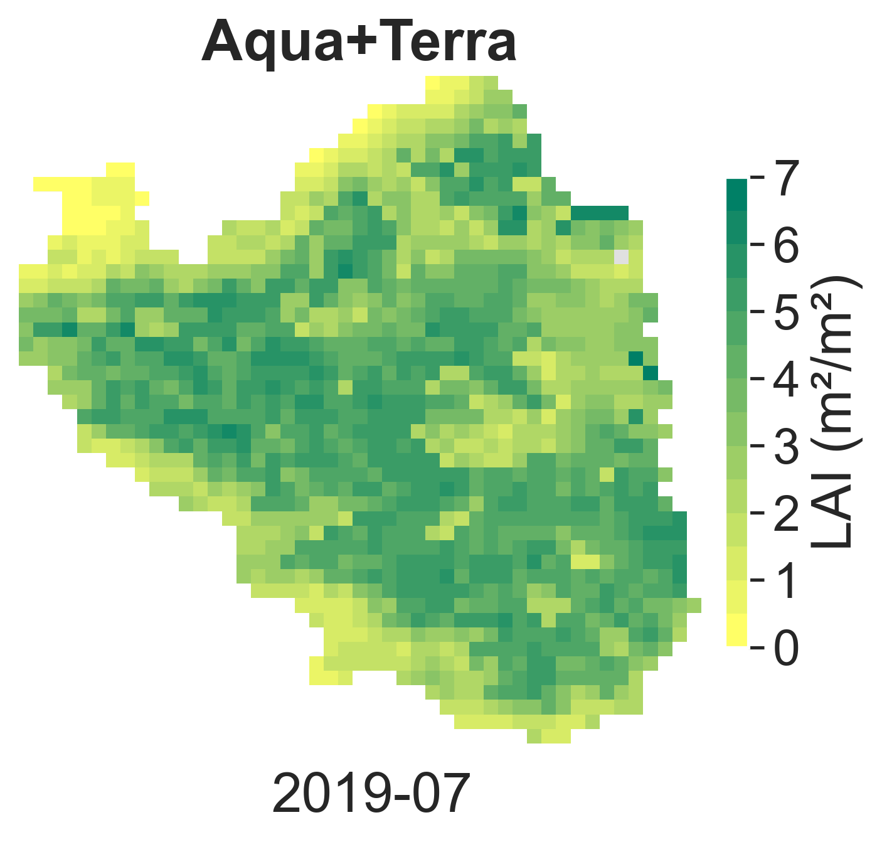
2. Study area and data
Evapotranspiratoin (ET)
MODIS: MOD16A2 (Terra), MYD16A2 (Aqua)
Temporal coverage: since 2001
Temporal resolution: 8 days
Spatial resolution: 465 m
Monthly accumulated series
Merge data
Leaf area index (LAI)
MODIS: MCD15A2H
Temporal coverage: since 2001
Temporal resolution: 8 days
Spatial resolution: 465 m
Monthly maximum series
Land cover
MODIS: MCD12Q1
since 2001
yearly
465 m

Slide 6
2. Methods
P T
β FC₀
evaporation
ET_{p} λ_{v} FC₂
2.1 Hydrological model: TETIS
rainfall
snowfall
Conceptual: tank-based
Spatially distributed: 100m
Temporal resolution: daily
I_{max}
T6:
interception
T0:
snowpack
throughfall
snowmelt
DDF₁ DDF₂ T_{b}
evapotranspiration
ET_{p} θ* λ_{v} FC₂
p₁
excess
H_{u} ∙ FC₁
T1:
static storage

Slide 7
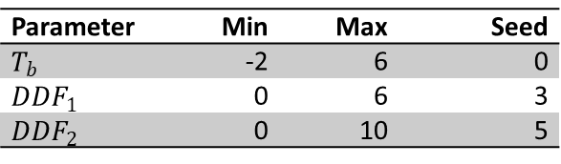
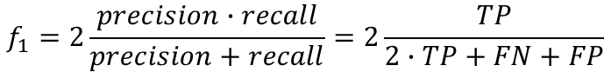
2. Methods
2.2 Snow cover
Degree-day method
Inputs: precipitation, temperature, radiation
Parameters:
T_{b}: snowmelt threshold
DDF₁: dry degree-day factor (mm/°C)
DDF₂: wet degree-day factor (mm/°C)
Output: snow-water equivalent (SWE)
P T
snowfall
SWE
T0:
snowpack
snowmelt
DDF₁ DDF₂ T_{b}
Calibration
Binary classification task.
Target: binary snow cover maps
Algorithm: SCE-UA (Duan, 1994) in SpotPy
Objective function: f1-score_micro in Scikit-Learn
Periods: 5 years calibration + 5 years validation
$$f_{1}=2\frac{precision∙recall}{precision+recall}=2\frac{TP}{2∙TP+FN+FP}$$
Parameter | Min | Max | Seed
$$T_{b}$$ | -2 | 6 | 0
$${DDF}_{1}$$ | 0 | 6 | 3
$${DDF}_{2}$$ | 0 | 10 | 5

Slide 8
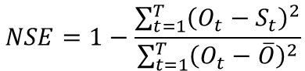
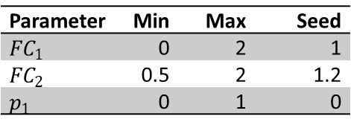
P T
2. Methods
evaporation
PET λ_{v} FC₂
rainfall
2.3 Evapotranspiration
TETIS
Inputs: precipitation, temperature, PET
Vegetation properties:
λ_{v}: monthly crop coefficients
I_{max}: maximum interception
Parameters:
FC₁ : field capacity multiplier
FC₂ : potential evapotranspiration (PET) multiplier
p₁: exponential infiltration coefficient
Output: daily series of actual evapotranspiration (AET)
I_{max}
T6:
interception
throughfall
evapotranspiration
PET θ* λ_{v} FC₂
p₁
H_{u} ∙ FC₁
T1:
static storage
Calibration
λ_{v} : from MODIS ET and land cover data
I_{max} : from MODIS LAI and Land Cover data
$$NSE=1−\frac{\sum_{t=1}^{T}{{\left(O_{t}−S_{t}\right)}^{2}}}{\sum_{t=1}^{T}{{\left(O_{t}−\overline{O}\right)}^{2}}}$$
FC₁, FC₂, p₁: automatic calibration
Target: monthly ET time series
Algorithm: SCEUA
Objective function: NSE
Periods: 4 years calibration + 10 years validation
Parameter | Min | Max | Seed
$${FC}_{1}$$ | 0 | 2 | 1
$${FC}_{2}$$ | 0.5 | 2 | 1.2
$$p_{1}$$ | 0 | 1 | 0

Slide 9
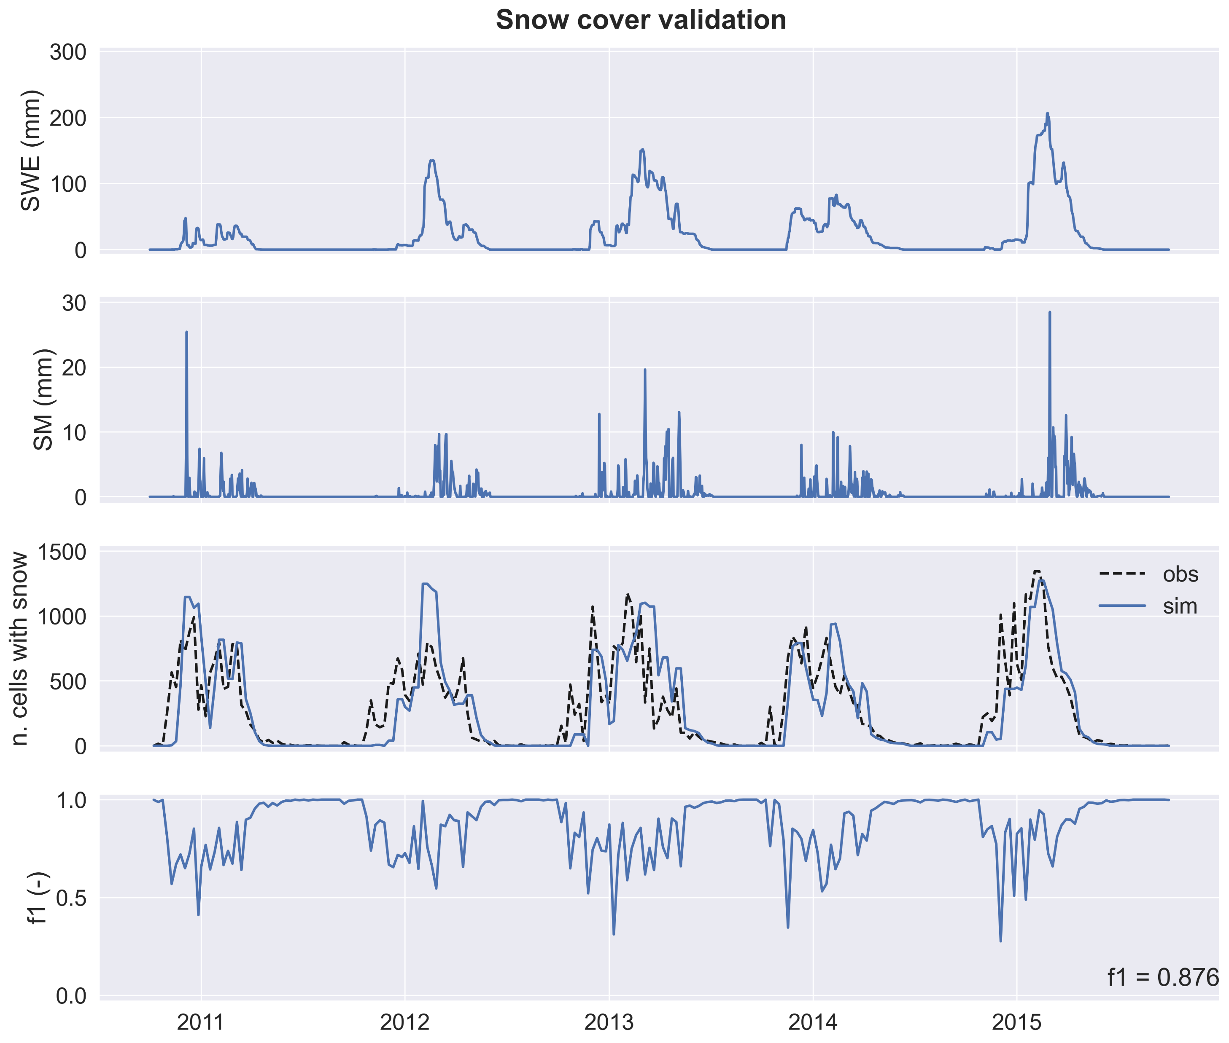
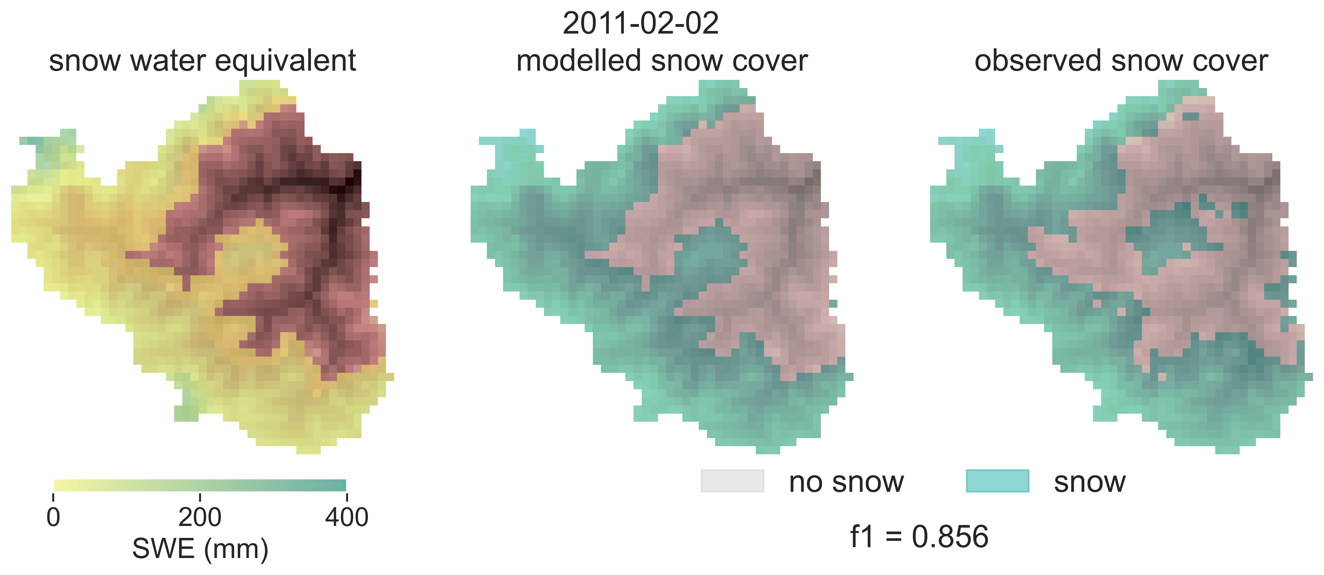
3. Results
3.1 Snow cover
T_{b} | DDF₁ | DDF₂ | f1 cal | f1 val
4.8 °C | 4.71 mm/°C | 8.82 mm/°C | 0.878 | 0.876
Lack of sensitivity.
Observed data is not reliable.

Slide 10
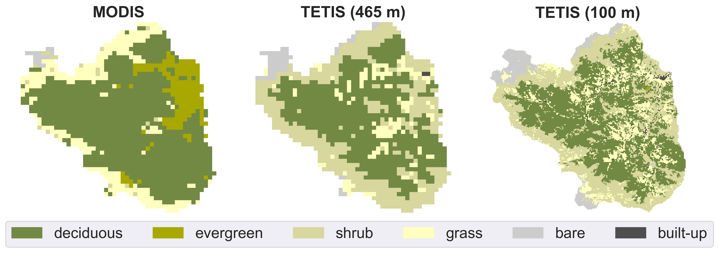
3. Results
3.2 Evapotranspiration
3.2.1 Land cover
MODIS misclassifies shrubland with evergreen forest and grassland.
MODIS
LANDSAT
Land cover | MODIS (%) | TETIS (%)
Deciduous forest | 67.8 | 43.2
Evergreen forest | 11.3 | 0.1
Shrub | 0.37 | 35.1
Grass | 17.1 | 14.7
Bare soil/sparse vegetation | 0.8 | 6.1
Snow or ice | 0.2 | -
Built-up | 0 | 0.8

Slide 11
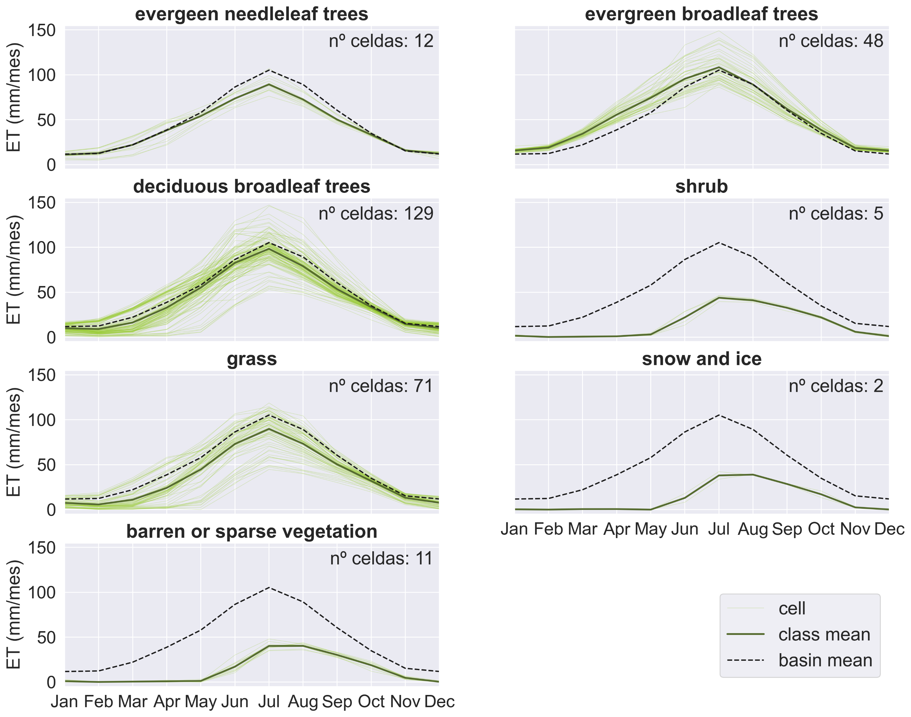
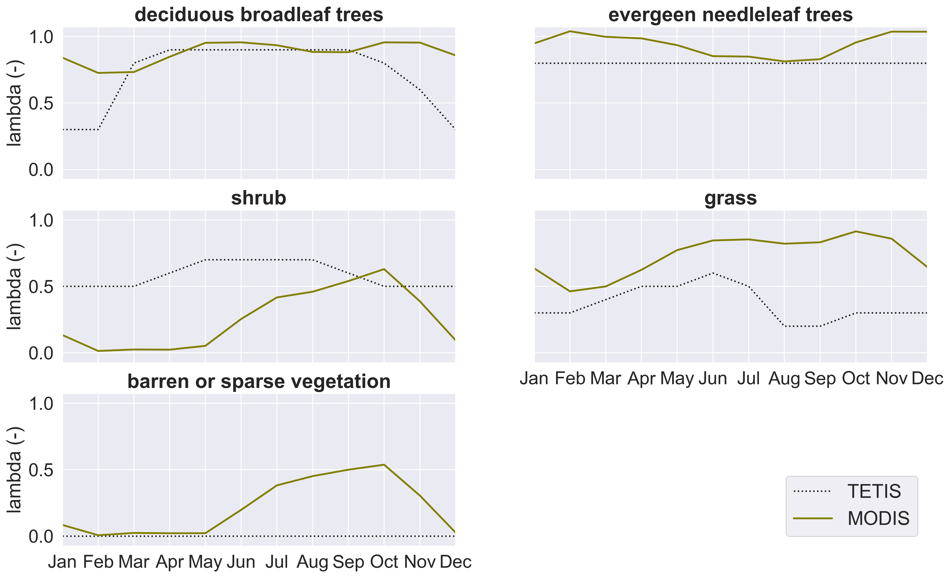
3. Results
3.2 Evapotranspiration
3.3.3 Crop coefficients
Great difference between the previous crop coefficients (literature) and those here fitted.
Evergreen forest: not constant
Shrub: significantly lower
Bare soil: not null in summer and autumn

Slide 12
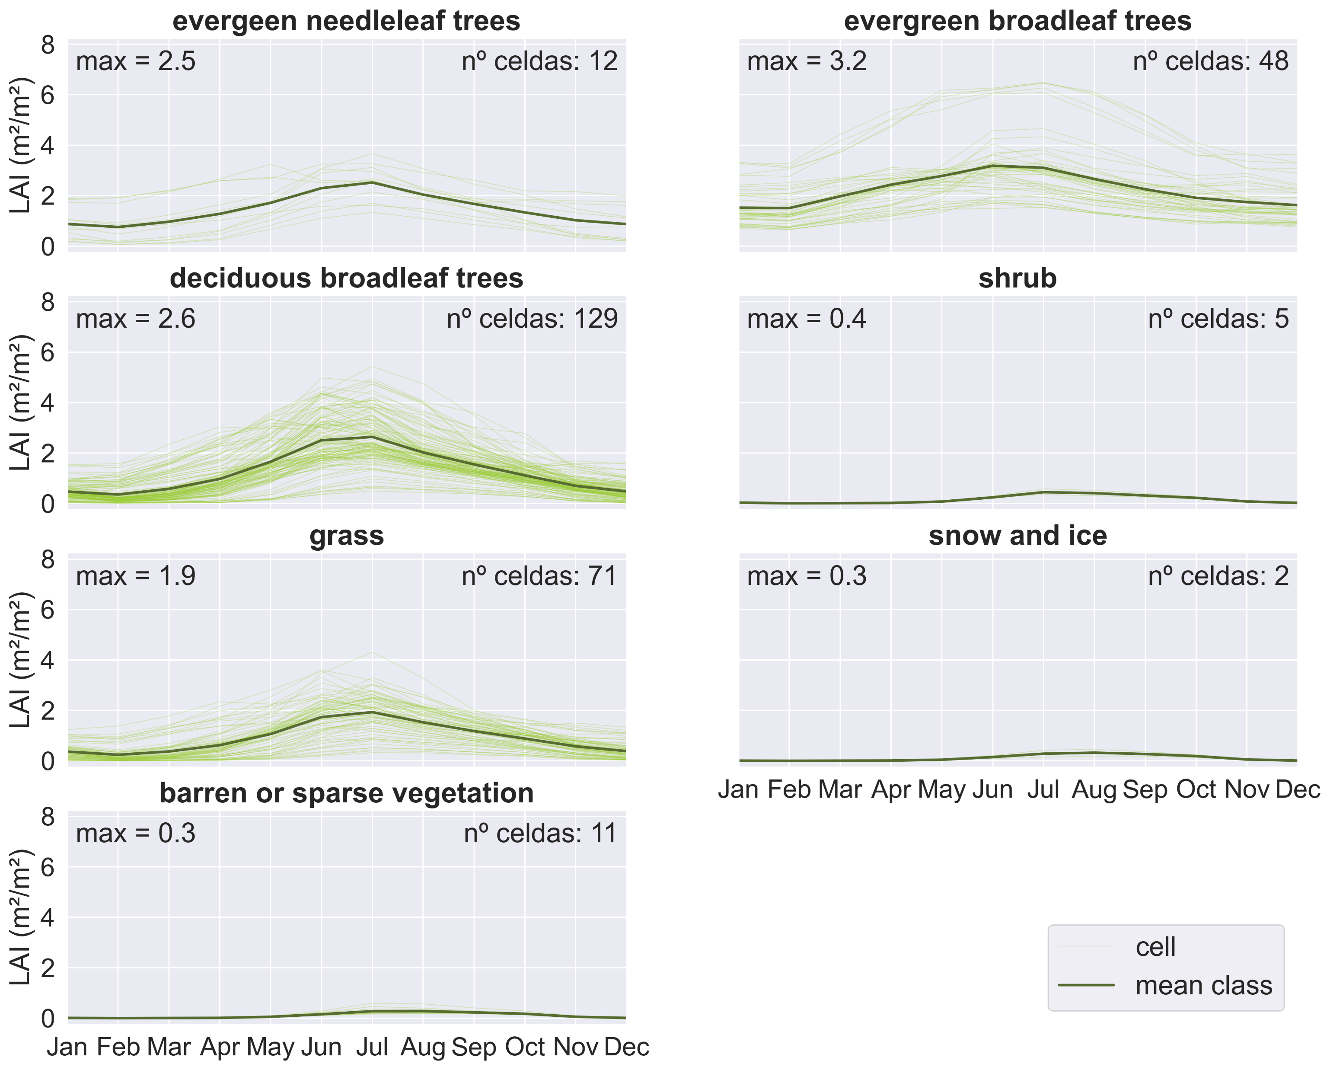
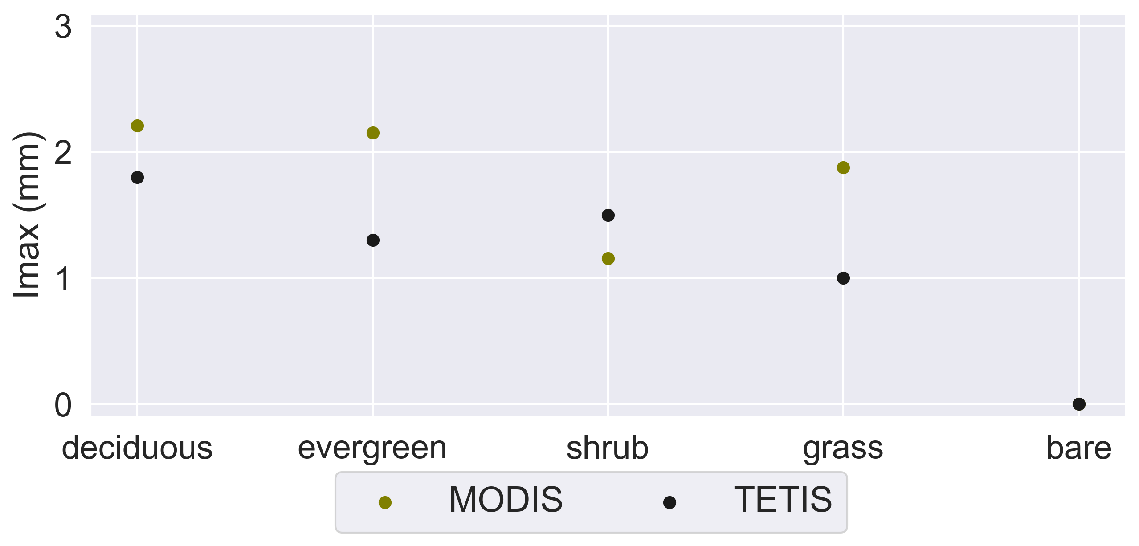
3. Results
3.2 Evapotranspiration
3.3.3 Maximum interception
Low LAI for shrub and relatively high for grass: land cover misclassification.
Calculate I_{max} from LAI (Wu et al., 2019), (De Jong & Jette, 2007):
$$I_{max}=0.935+0.498∙LAI−0.00575∙{LAI}^{2}$$
Maximum interception is, overall, larger with the methodology here employed.

Slide 13
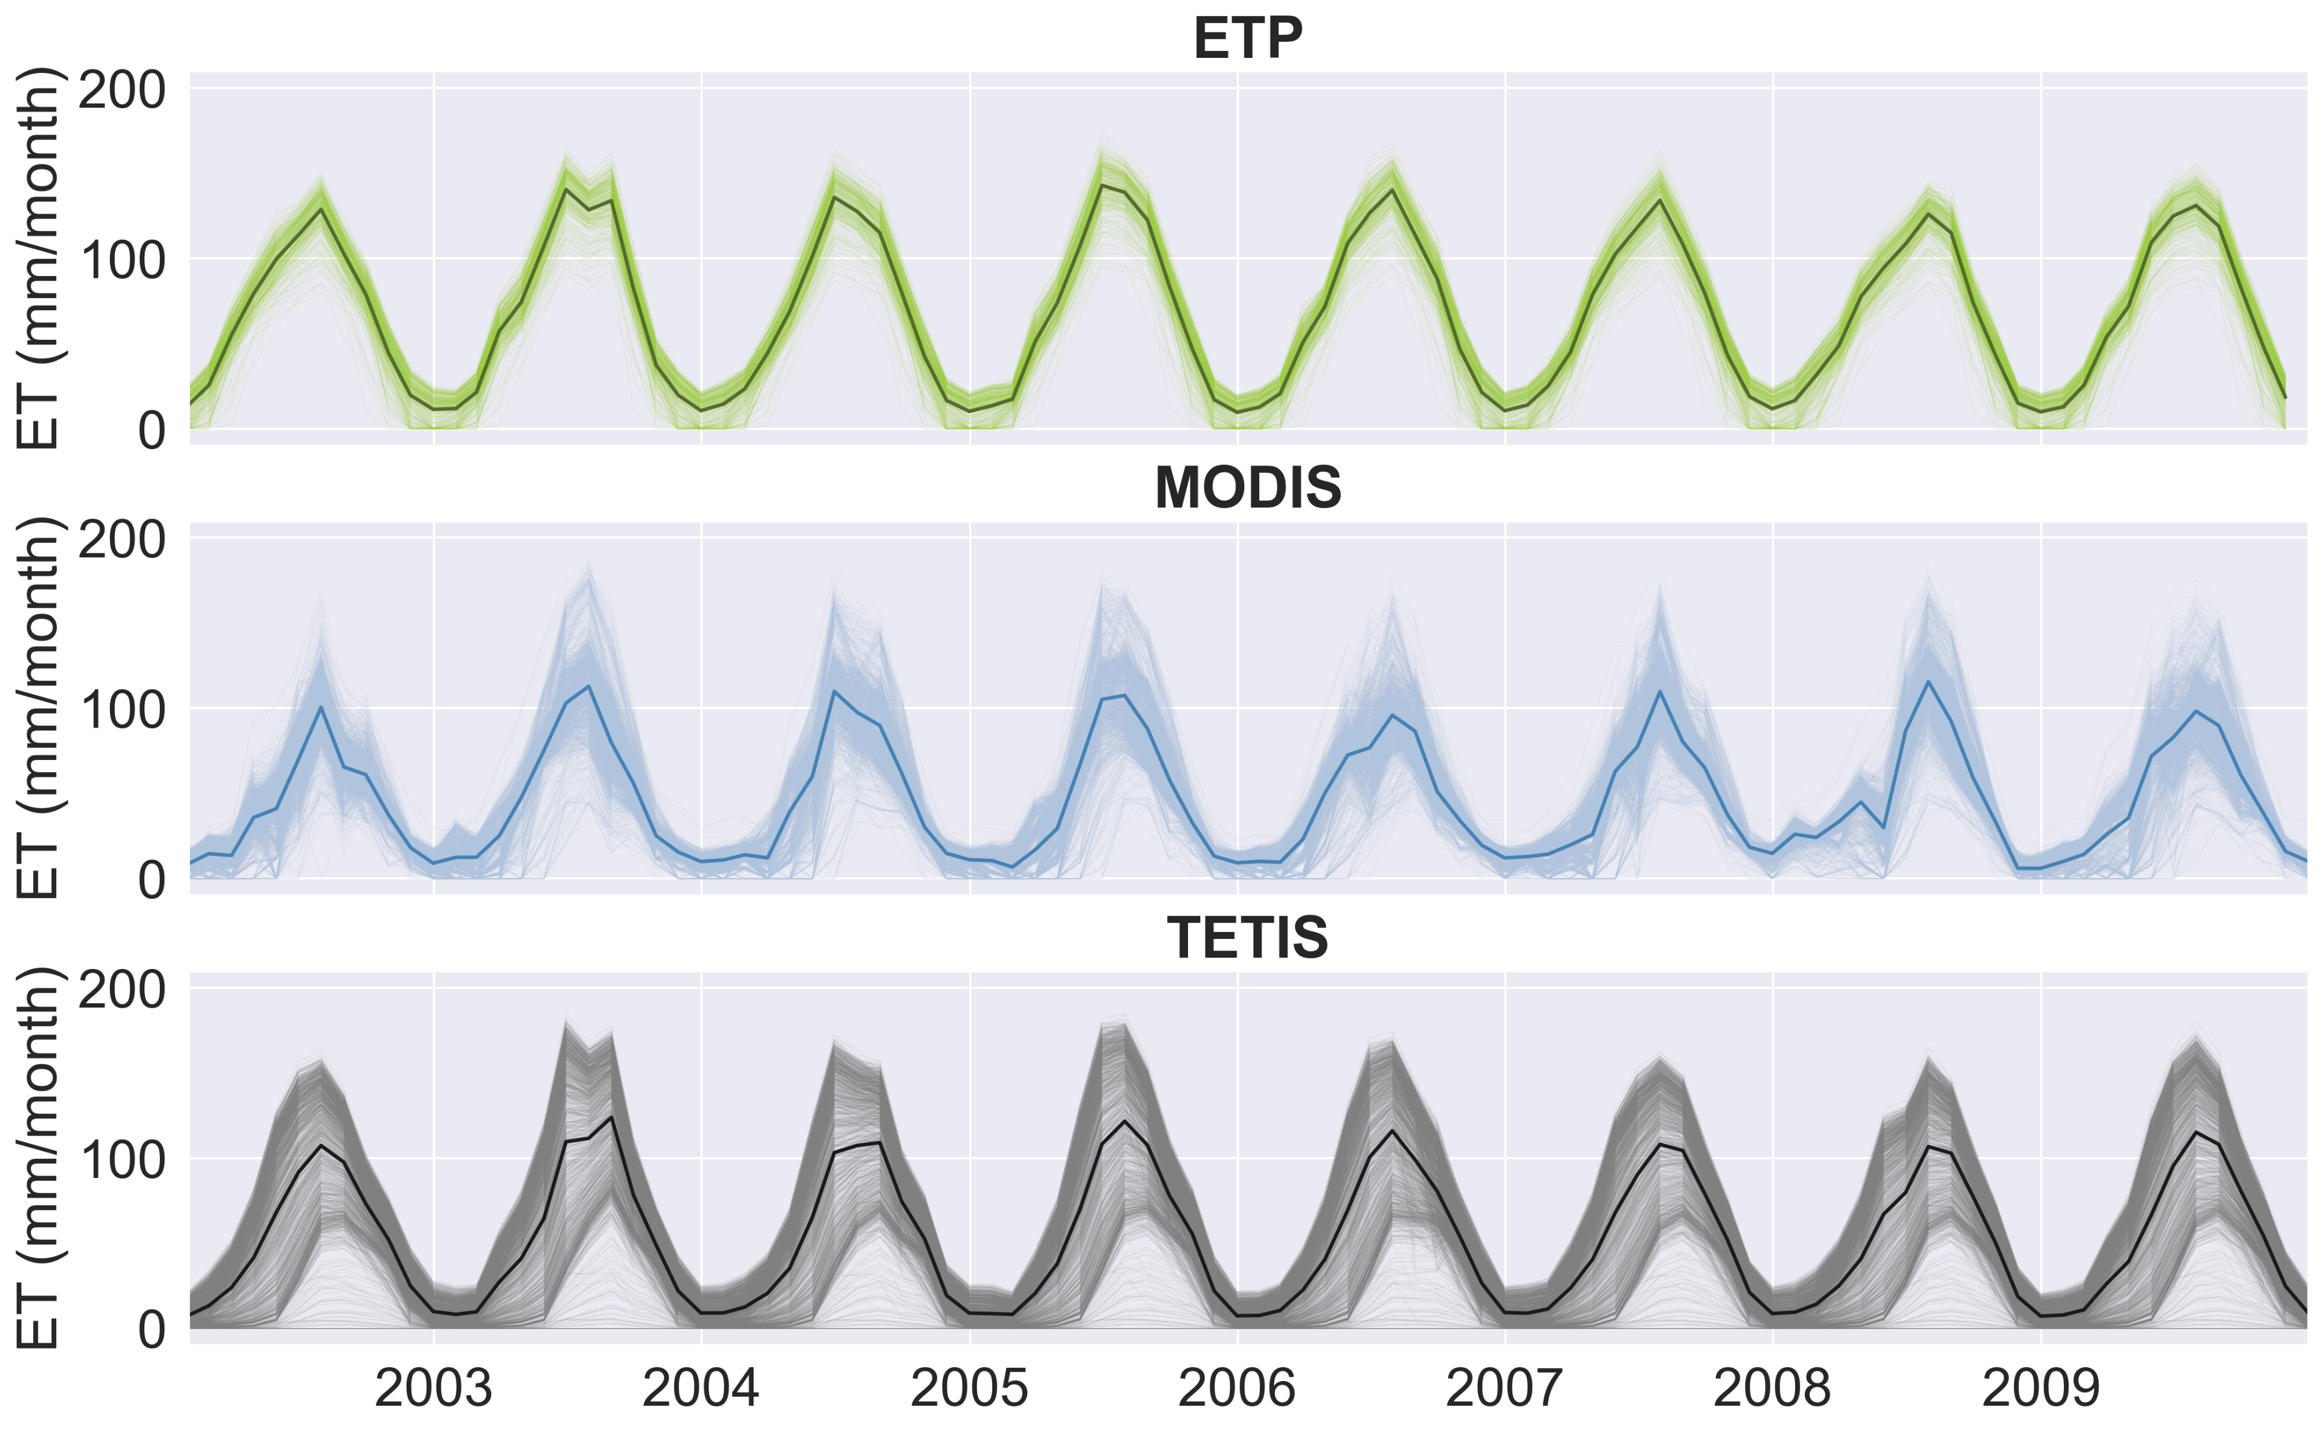
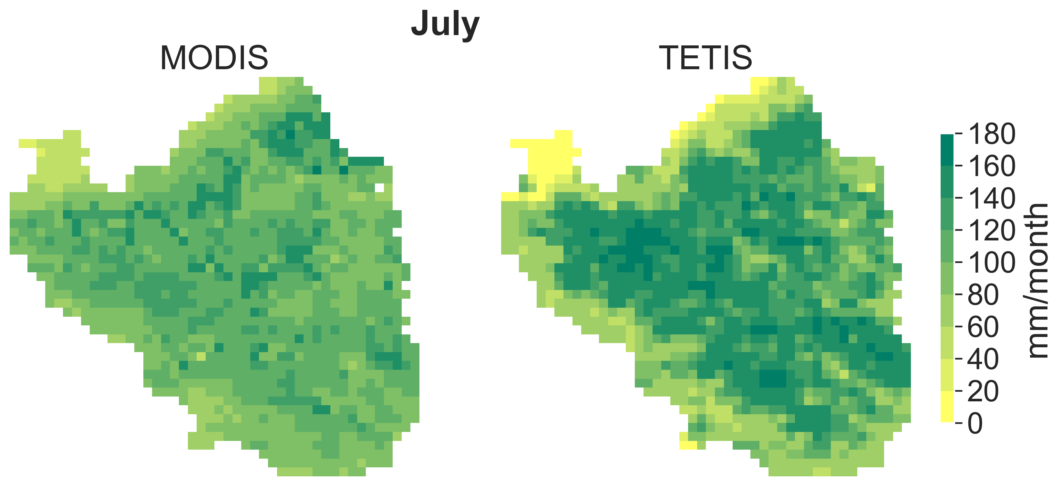
3. Results
3.2 Evapotranspiration
3.3.4 Model parameters
Very high performance both in the calibration and validation periods.
Parameters are not sensitive.
FC1 | FC2 | p1 | NSE cal | NSE val
1.756 | 1.236 | 0.107 | 0.93 | 0.90

Slide 14
4. Conclusions
Methodology to use MODIS products in the calibration of surface processes in a conceptual hydrological model.
Progress
Future developments
Snow processes
Calibration of the model parameters to reproduce binary snow cover maps.
Calibration of SWE instead of snow cover.
Apply a spatial objective function instead of the f1 score.
Evapotranspiration
Estimate vegetation properties from satellite observations.
Calibrate model parameters to reproduce monthly ET series.
Use a hydrological model with a more flexible vegetation submodel (dynamic vegetation).
Apply a spatial objective function instead of NSE.

Slide 15
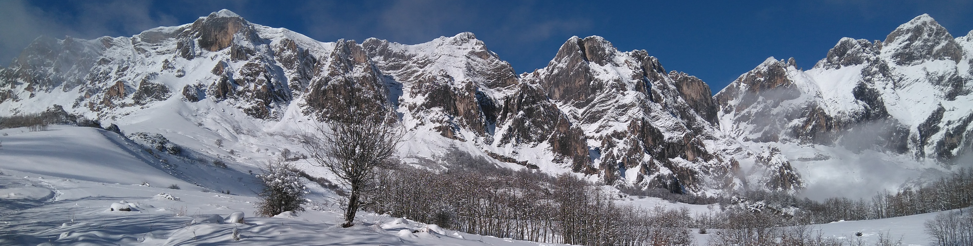

Thank you for your attention

